Slide 1


Foundations of
Scientific Computing
(SciComp 101)
Dave Biersach
dbiersach@bnl.gov
Session 04
Functions and Logic

Slide 2
Session 04 – Goals
Understand statements and scopes
Declare custom functions using the def keyword
Create a for loop to enumerate over a range of numbers
Use np.arange() to create an array containing numbers in the closed-open interval [start, stop) using a given step size
Utilize an if statement to enable conditional code execution based on a logical expression
Make a code scope run repeatedly using a while statement
Leverage np.where() to select items within an array
Discover Perfect Numbers using the modulus operator

Slide 3
Statements and Scopes
A statement does something (think: sentence)
A statement is either a declaration, a keyword, or a function
Statements are executed from top to bottom of a scope
A scope contains one or more statements (think: paragraph)
A scope in Python begins with a colon :
Scopes are also denoted via indentation
All the statements in a scope must start at the same column
Scopes can be nested – each inner scope is further indented
Certain Python statements "introduce" (require) a new scope
In Python, white space is significant – indentation matters!

Slide 4

Statements and Scopes
A for loop introduces a scope with a colon :
An if statement introduces a scope with a colon :
Statements within a scope are indented

Slide 5

Defining a function
def is how we define a function
The function name
The inbound parameters
A function introduces a scope
Functions can return a value
Functions are just "named" scopes!

Slide 6
Use range() to Create a Sequence
It is common to use the range() function to generate a sequence of numbers within some interval
The range() function takes three parameters: (start, stop, step)
The stop value is required but the start and step values are optional
The default value (if unspecified) for start is 0 and for step is 1
The range is inclusive, exclusive: [start, stop)

Slide 7
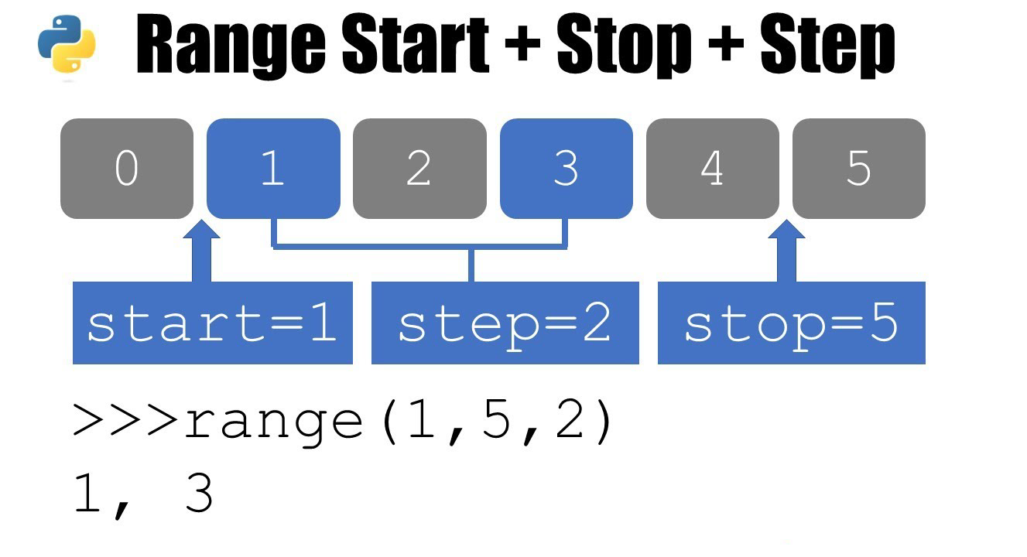
Use range() to Create a Sequence

Slide 8
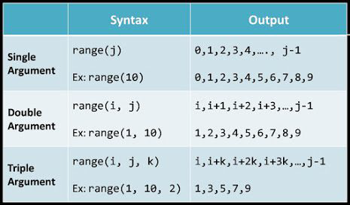
Use range() to Create a Sequence

Slide 9
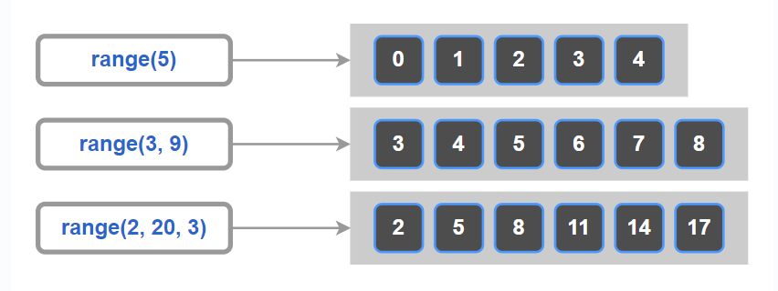
Use range() to Create a Sequence

Slide 10
for loops
A for loop executes all the statements within its scope for each number within a given range
It is common to use the range() function to create the array of numbers passed into the for statement
The range() function takes three parameters: (start, stop, step)
The stop value is required but the start and step values are optional
The default value (if unspecified) for start is 0 and for step is 1
The range is inclusive, exclusive: [start, stop)

Slide 11
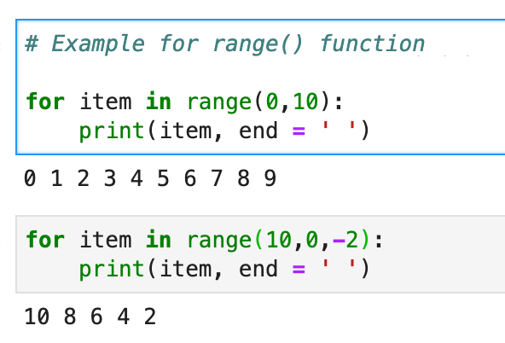
for loops

Slide 12
for loops

Slide 13
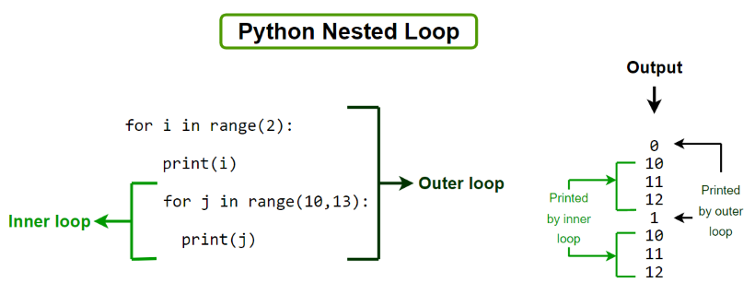
for loops

Slide 14
if Statement
An if statement identifies which code block (scope) to run based on the value of a Boolean expression
The expression (the condition) must evaluate to either a True or a False value
If the condition is True, then the scope immediately following the if statement is executed
If the condition is False, and there is an else clause, then the scope immediately following the else statement is executed
Every if statement does not need to have an else clause
You can also use elif to continue to test for other conditions
The if, elif, and else statements all introduce scopes (meaning they require a colon at the end of their line)

Slide 15
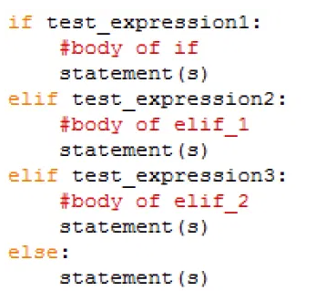
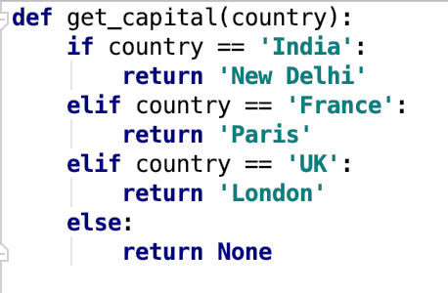
if Statement
def is how we define a function
Functions can return values
Be mindful of the colons : that start the scopes

Slide 16
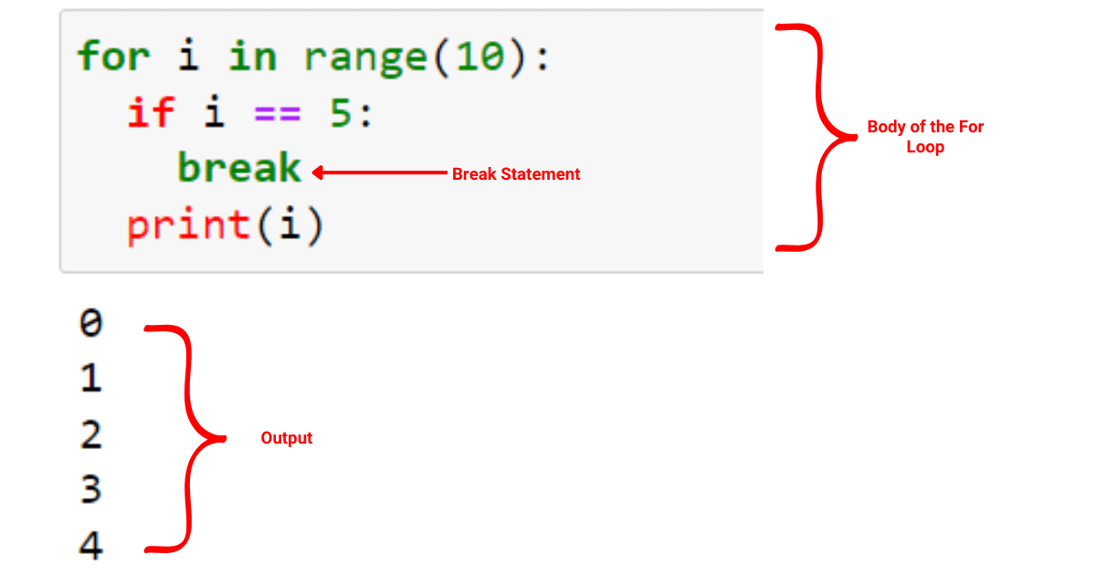
if Statement
The break statement immediately exits from the closest enclosing loop structure

Slide 17
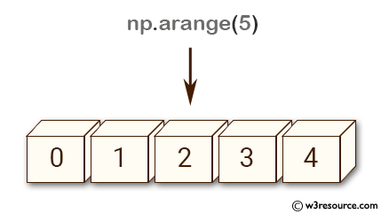
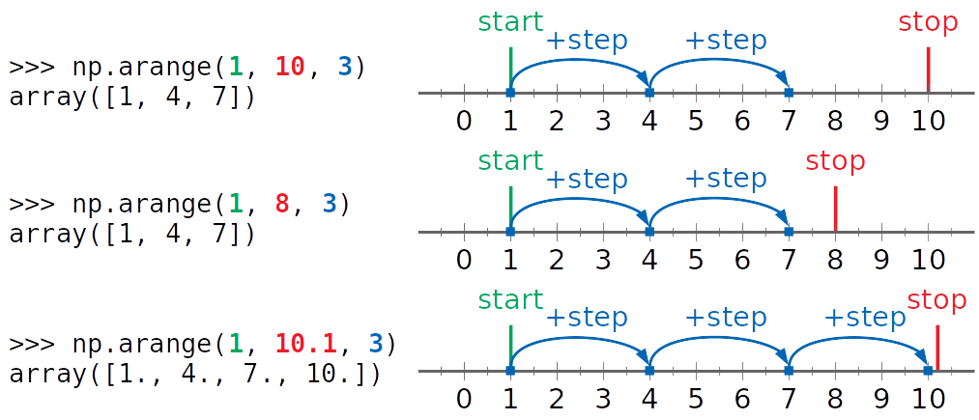
Create a Numpy Array from a Range
Just like range()
the default start value is 0 and the default step value is 1, and the stop value is exclusive
Creates a "street" of mailboxes where the value inside each mailbox follows the requested range

Slide 18
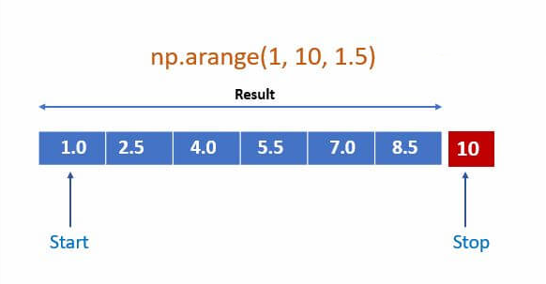
Create a Numpy Array from a Range

Slide 19
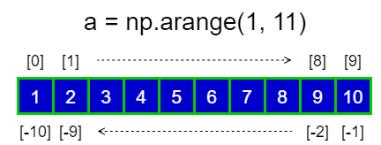
Create a Numpy Array from a Range

Slide 20
The Modulus (%) Operator
The “mod” operator (%) returns the integer remainder of an implicit division operation, e.g., 37 % 5 = 2
Use double equals operator (==) when testing for equality

Slide 21
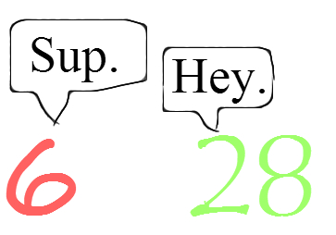
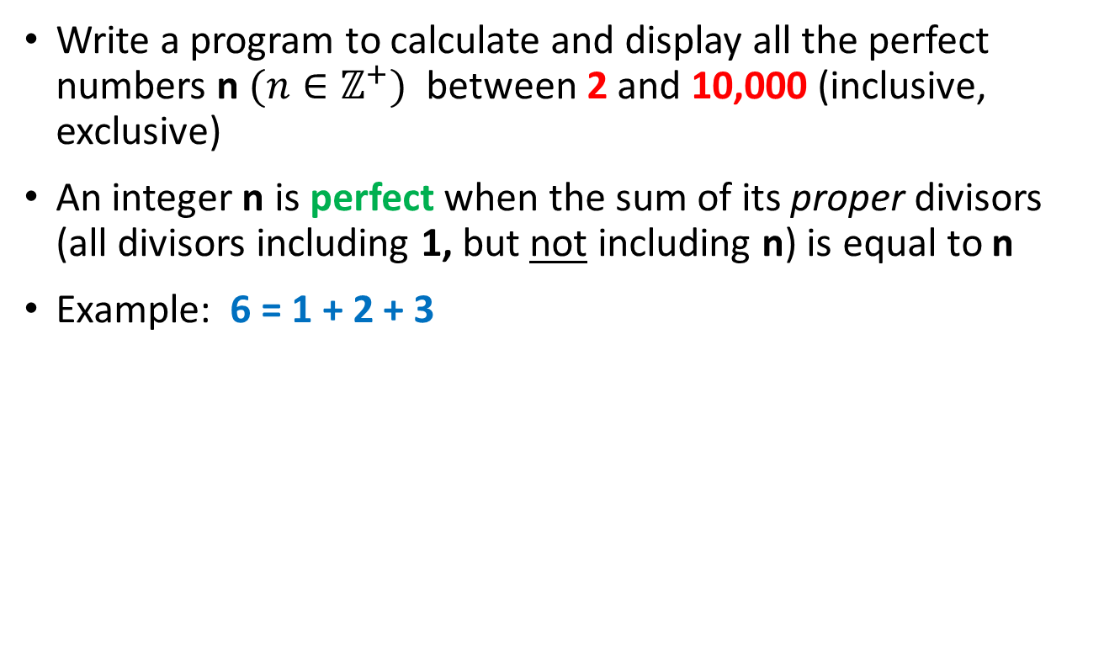
Perfect Numbers
Write a program to calculate and display all the perfect numbers n $(n∈ℤ^{+})$ between 2 and 10,000 (inclusive, exclusive)
An integer n is perfect when the sum of its proper divisors (all divisors including 1, but not including n) is equal to n
Example: 6 = 1 + 2 + 3

Slide 22
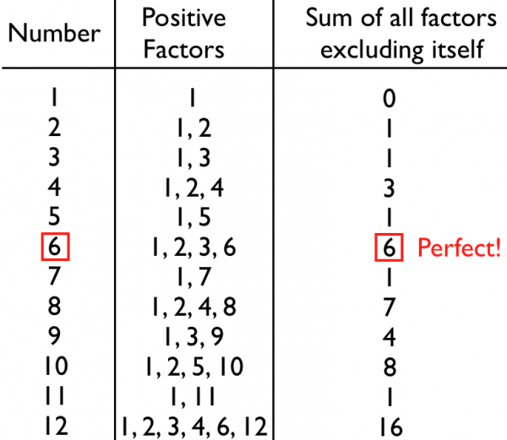
Perfect Numbers

Slide 23
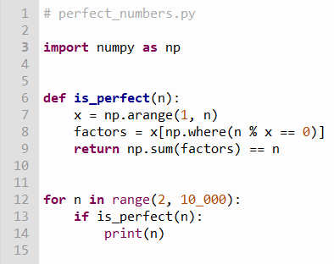
Edit perfect_numbers.py
③
④
⑤
⑥
①
②
⑦
np.where() returns all the index numbers within an array where the condition is true for any of its elements
factors[] is now an array containing only the elements in x[] where the condition was true

Slide 24

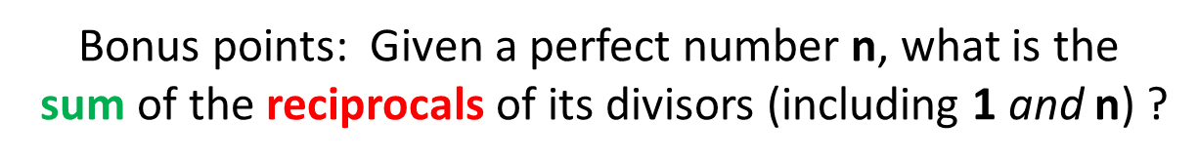
Run perfect_numbers.py
Do you notice anything special about these numbers?

Slide 25
Perfect Numbers
Euclid–Euler theorem
$$\left\{p,\left(2^{p}−1\right) \right\}∈primes→2^{\left(p−1\right)}\left(2^{p}−1\right) is perfect$$
Note: This formula might not be the only one to generate perfect numbers – we still don't know for sure!

Slide 26
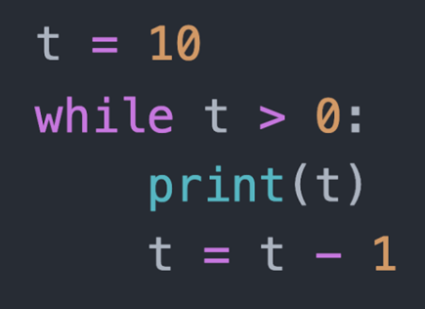
while Loop
A while loop executes all the statements within its scope as long as the loop conditional remains True
The loop conditional
A while loop introduces a scope

Slide 27
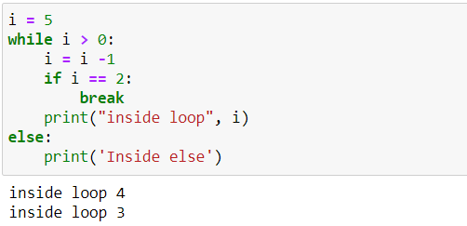
while Loop

Slide 28

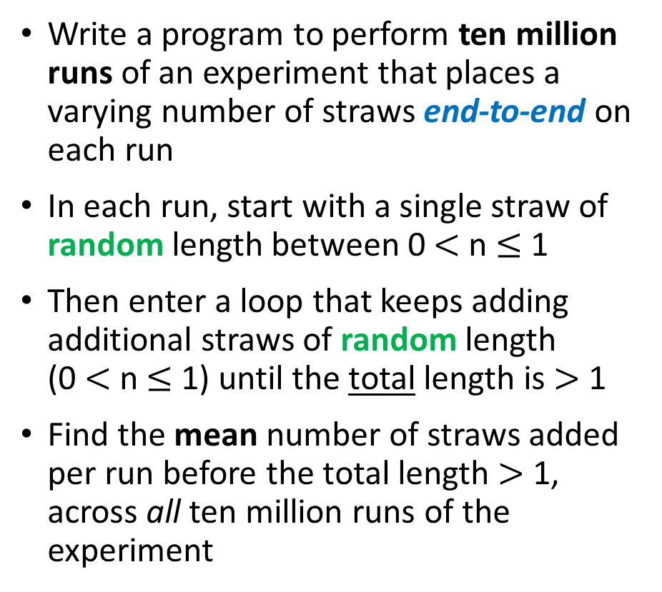
Random Straws
Write a program to perform ten million runs of an experiment that places a varying number of straws end-to-end on each run
In each run, start with a single straw of random length between 0 $<$ n $≤$ 1
Then enter a loop that keeps adding additional straws of random length (0 $<$ n $≤$ 1) until the total length is $>$ 1
Find the mean number of straws added per run before the total length $>$ 1, across all ten million runs of the experiment

Slide 29
Random Straws
0.63
1.0
0.89
Straws
0.13
0.89
0.63
1
0.13
0.45
2
0.13
0.76
Run # 1
3
1.21
1
0.13
Run # 2
2
1.02
0.13
0.76
1
0.13
0.07
0.25
2
0.13
0.20
Run # 3
0.07
3
0.13
0.25
0.45
0.07
4
1.21

Slide 30
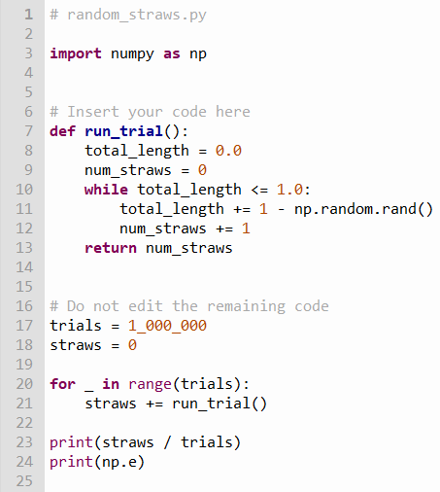
Edit random_straws.py
np.random.rand()
returns a random number [0,1)
④
⑤
⑥
⑦
⑧
⑨
x += 1 is the same as x = x + 1
The underscore _ symbol is the anonymous
("I don't care") variable placeholder
①
②
③
⑩

Slide 31
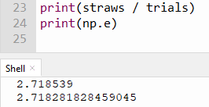
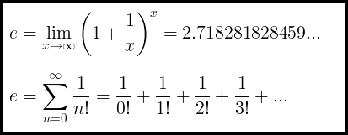
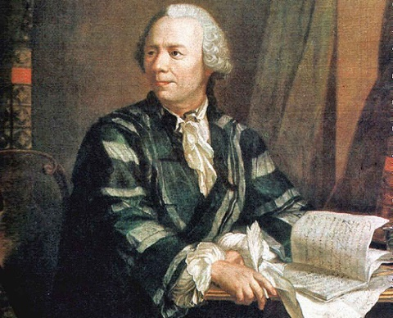
Run random_straws.py
We just estimated the base of the natural logarithm using nothing but random numbers!
We can estimate complicated calculations using nothing but random numbers!
Leonhard Euler
(1707 – 1783)

Slide 32
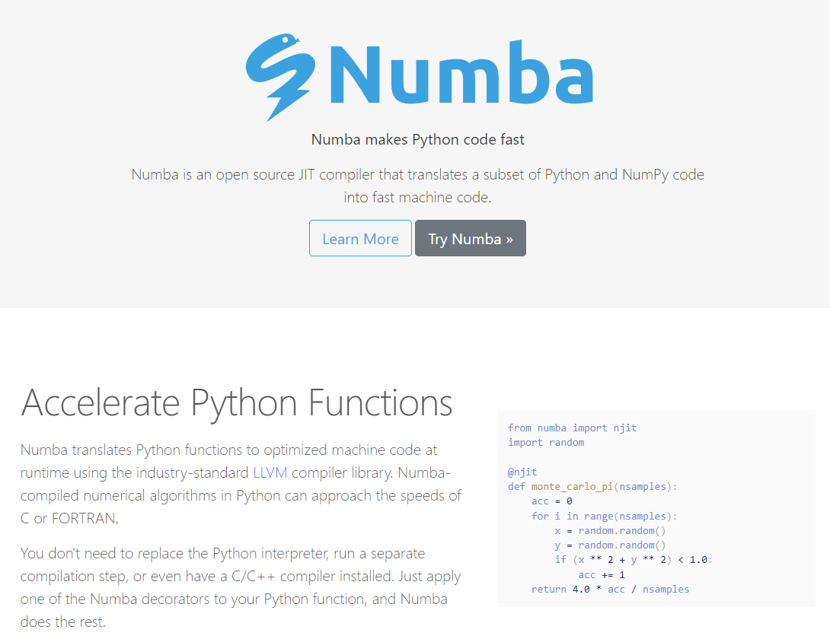
The Numba Package
https://numba.pydata.org

Slide 33
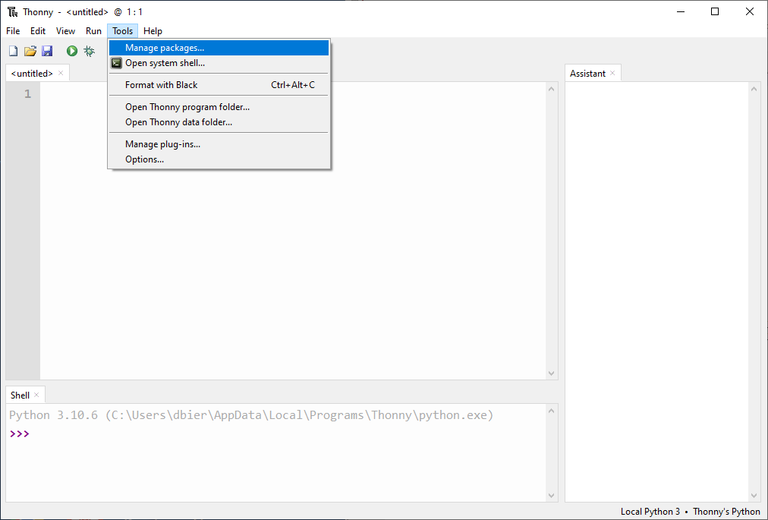
Installing the Numba Package into Thonny

Slide 34
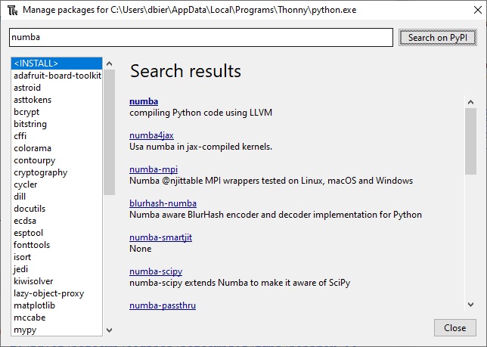
Search for the Numba package

Slide 35
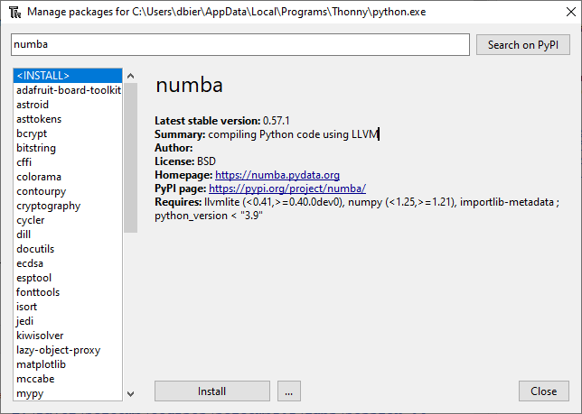
Install the Numba Package

Slide 36
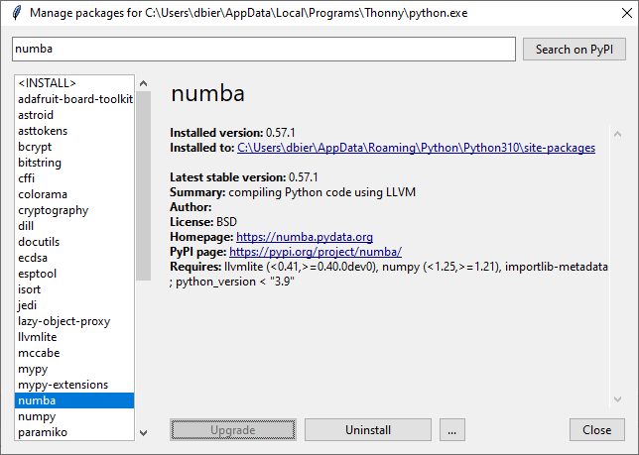
Verify the Numba Package Installation

Slide 37
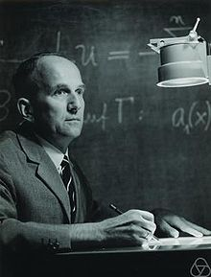
The Collatz Conjecture
First proposed in 1945 by Lothar Collatz, it remains unsolved
Take any positive integer n
If n is even, divide it by 2
If n is odd, multiply it by 3 and add 1
Repeat the process until n reaches 1
The conjecture is that no matter what integer you start with the process will always reach 1
It is maddening simple to state, but no one has been able to prove this claim is either true or false!
What is the sequence for 26 ?

Slide 38
The Collatz Conjecture
26
13
40
20
10
5
16
8
4
2
1
If n is even, divide it by 2
If n is odd, multiply it by 3 and add 1
Repeat the process until n reaches 1
What is the sequence for 26 ?
What is the sequence for 27 ?
26 took 10 steps to reach 1

Slide 39
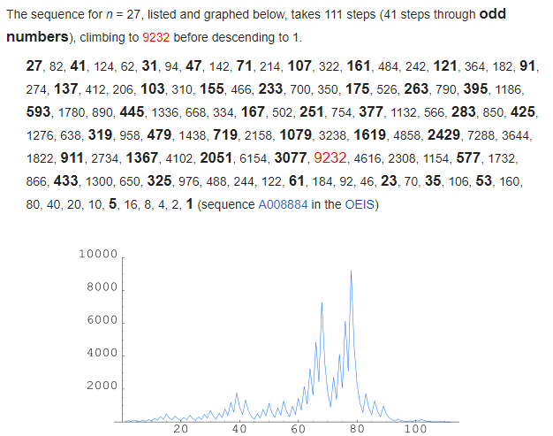
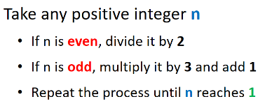
The Collatz Conjecture
Step Value
Step Count

Slide 40
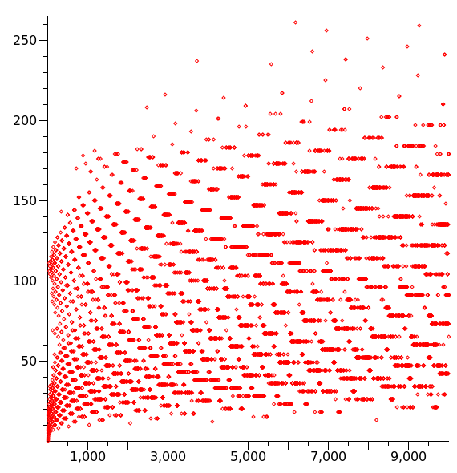
Stopping Time
The stopping time (for a given integer n) is the total number of Collatz iterations before reaching 1
This graph shows the stopping times for n < 10,000
Stopping times appear to exhibit a rough pattern, but we have no formula to accurately predict it for any n
Stopping Time
Increasing n

Slide 41
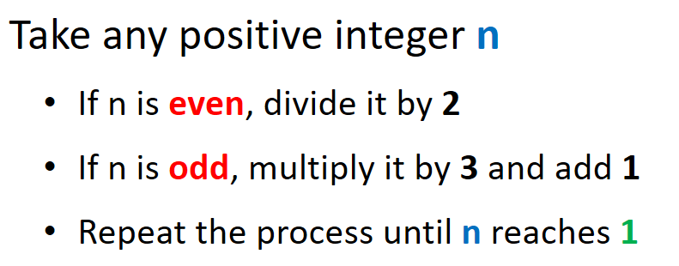
Frequency of Stopping Times
We are interested in analyzing the frequency (count) of each stopping time for n < 1,000,000
What is the overall shape of the distribution of stopping times?
We will use a histogram to display the count of each stopping time
Your task is to implement the stopping time function:

Slide 42
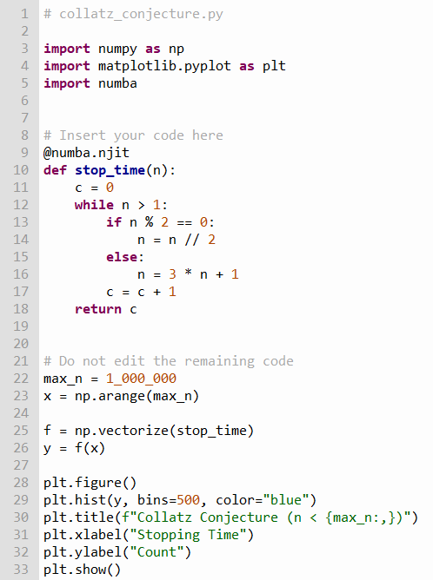
Edit collatz_conjecture.py
①
⑥
⑦
⑧
⑨
②
③
④
np.vectorize() helps a function become "vector aware" so it can act on a numpy array
⑤
⑩

Slide 43
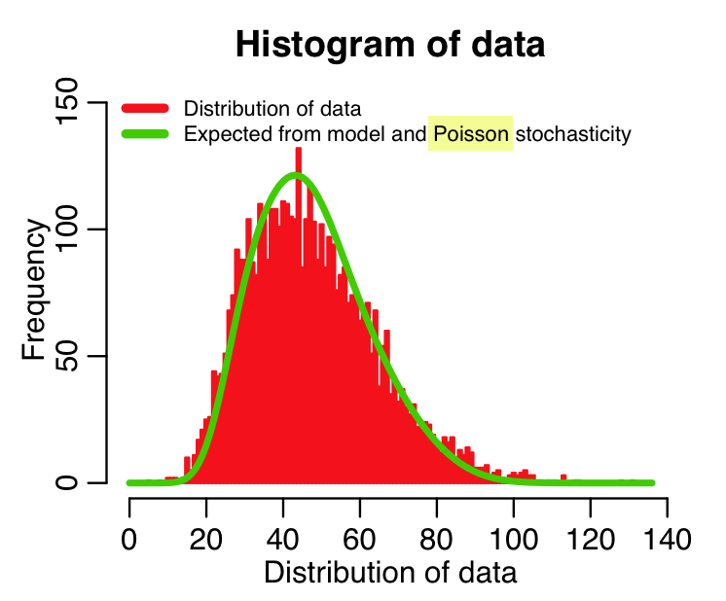
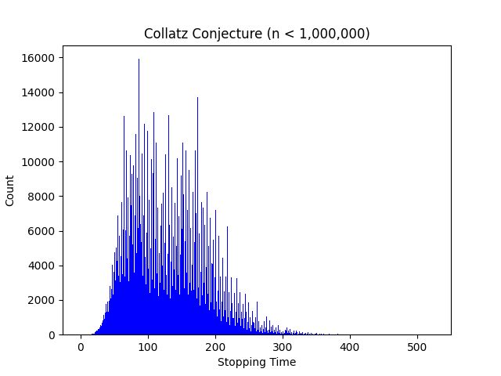
Run collatz_conjecture.py
Would you have guessed the stopping time distribution takes this shape?

Slide 44
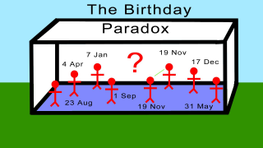
Birthday Paradox
Given a class size of n students, write a program to calculate the probability that at least two students in that class share the same birthday
Your code should calculate this probability for 10,000 classes, each between 2 and 80 students inclusive
Assume there is only 365 days in a year (no leap years)
What is the minimum required class size to have > 50% probability of two similar birthdays?

Slide 45
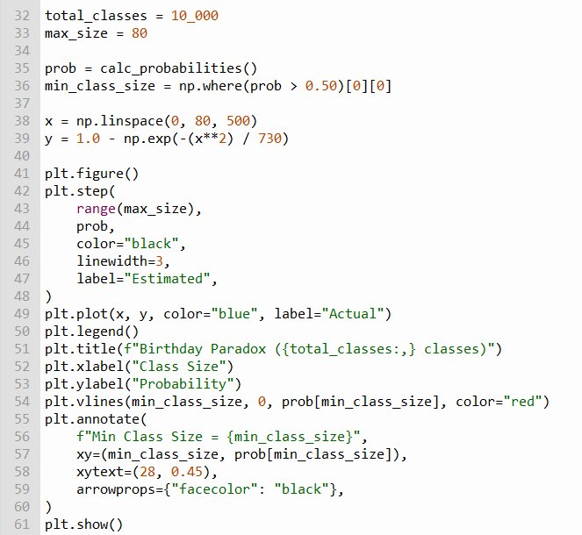
Open birthday_paradox.py
Note: You should not edit this file!
①
②
③
④
⑤
⑥
⑦
⑧

Slide 46
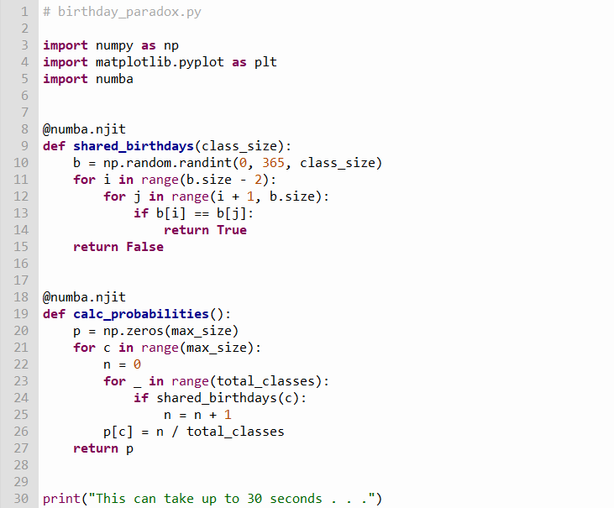

View birthday_paradox.py
①
②
③
④
⑤
⑥
⑦
⑧
⑨

Slide 47
View birthday_paradox.py
①
②
③
④
⑤
⑥
⑦

Slide 48
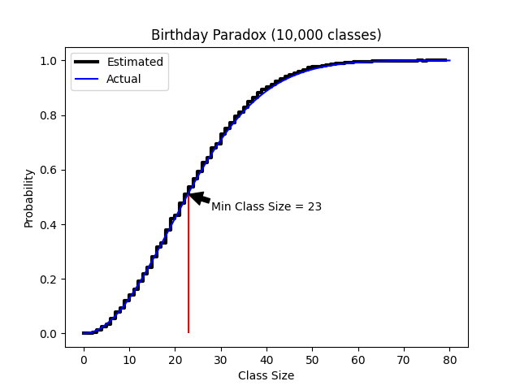
Run birthday_paradox.py
This can take up to 30 secs
②
①

Slide 49
Session 04 – Know You Know…
How to identify statements and scopes
How to define your own custom functions using def()
How to create a for() loop to enumerate over a range()
That np.arange() creates an array containing numbers in the closed-open interval [start, stop) using a given step size
How to execute scopes based upon a condition using if
How to make a scope loop using the while statement
How to use np.where() function to select elements of an array that match a condition
The Numba compiler is a package that can significantly accelerate your Python code

Slide 50
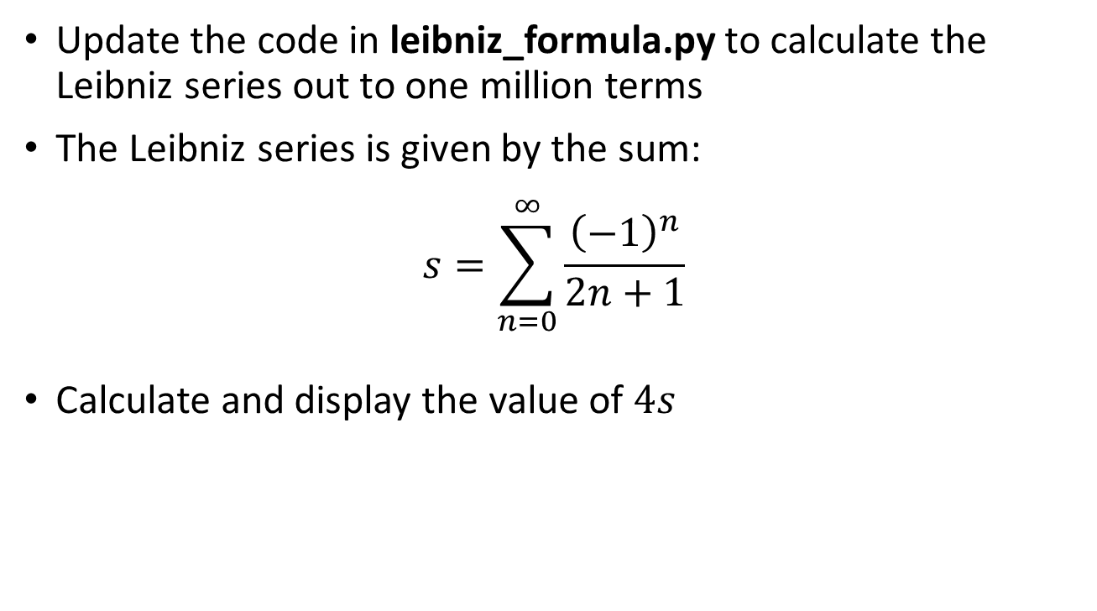
Task 04
Update the code in leibniz_formula.py to calculate the Leibniz series out to one million terms
The Leibniz series is given by the sum:
$$s=\sum_{n=0}^{∞}{\frac{{\left(−1\right)}^{n}}{2n+1}}$$
Calculate and display the value of $4s$

